Slide 1
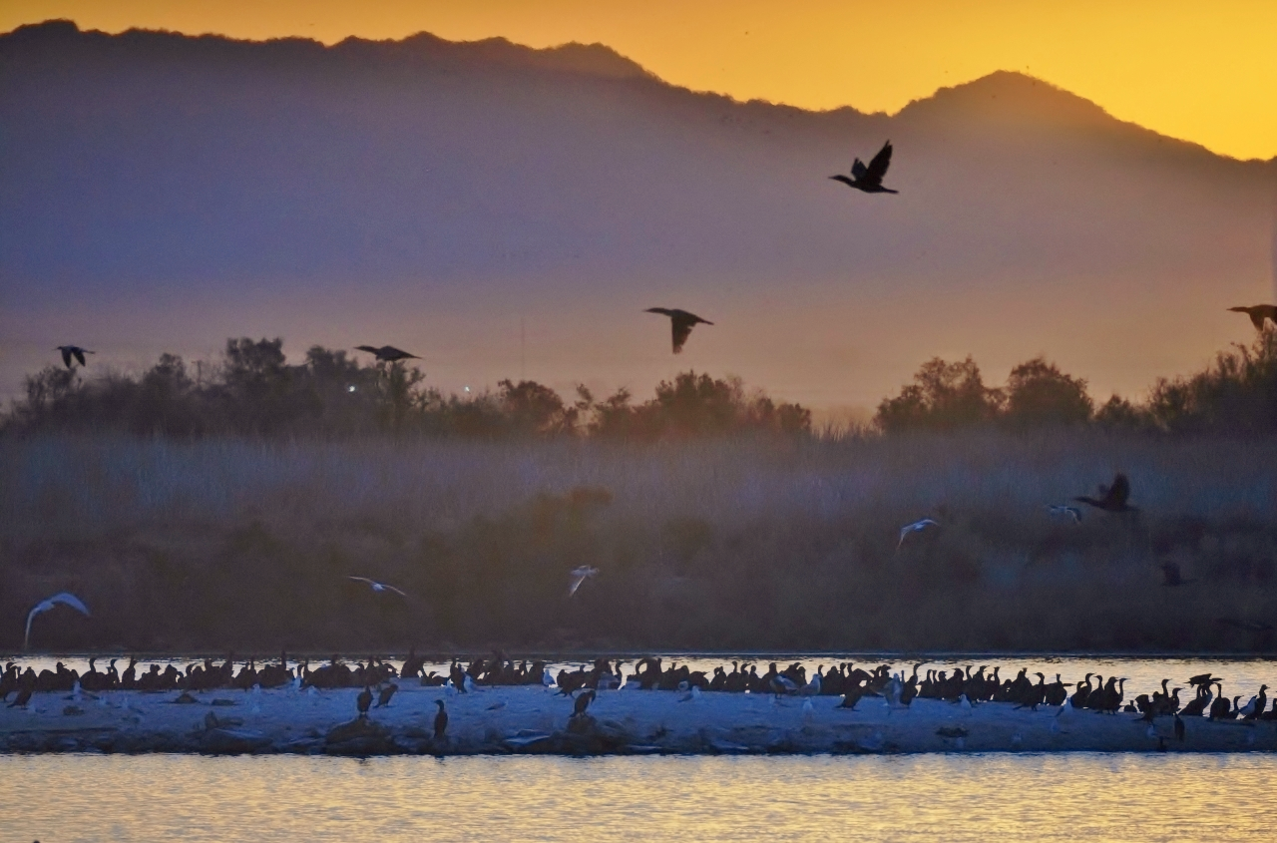
HISTORIC STEPS TO REVITALIZE
THE SALTON SEA

Slide 2
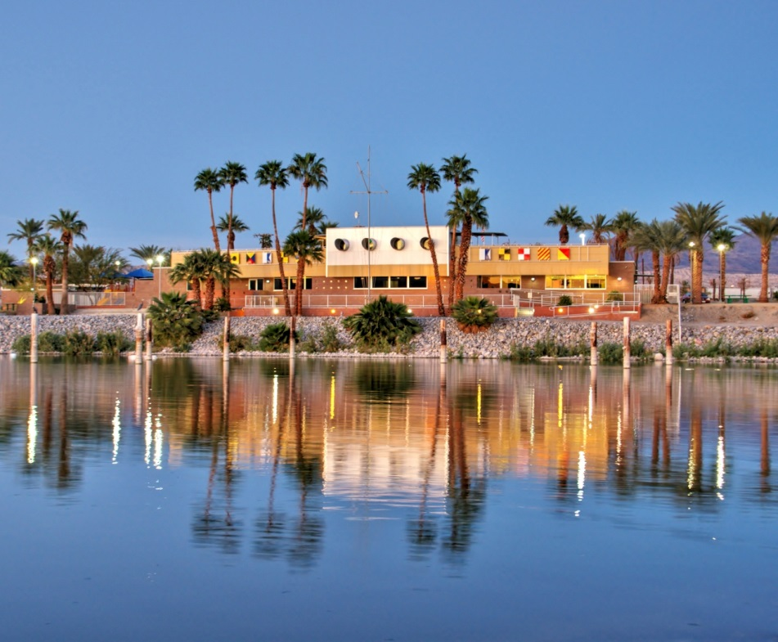
Salton Sea Authority
What is the SSA? Who are the members?
When was it created, and by whom?
Why was it created and what is its mission?

Slide 3
Challenges & Opportunities
Human Health impacted by Air Quality
Habitat loss impacting Pacific Flyway
Opportunities: Renewable Energy, Recreation

Slide 4
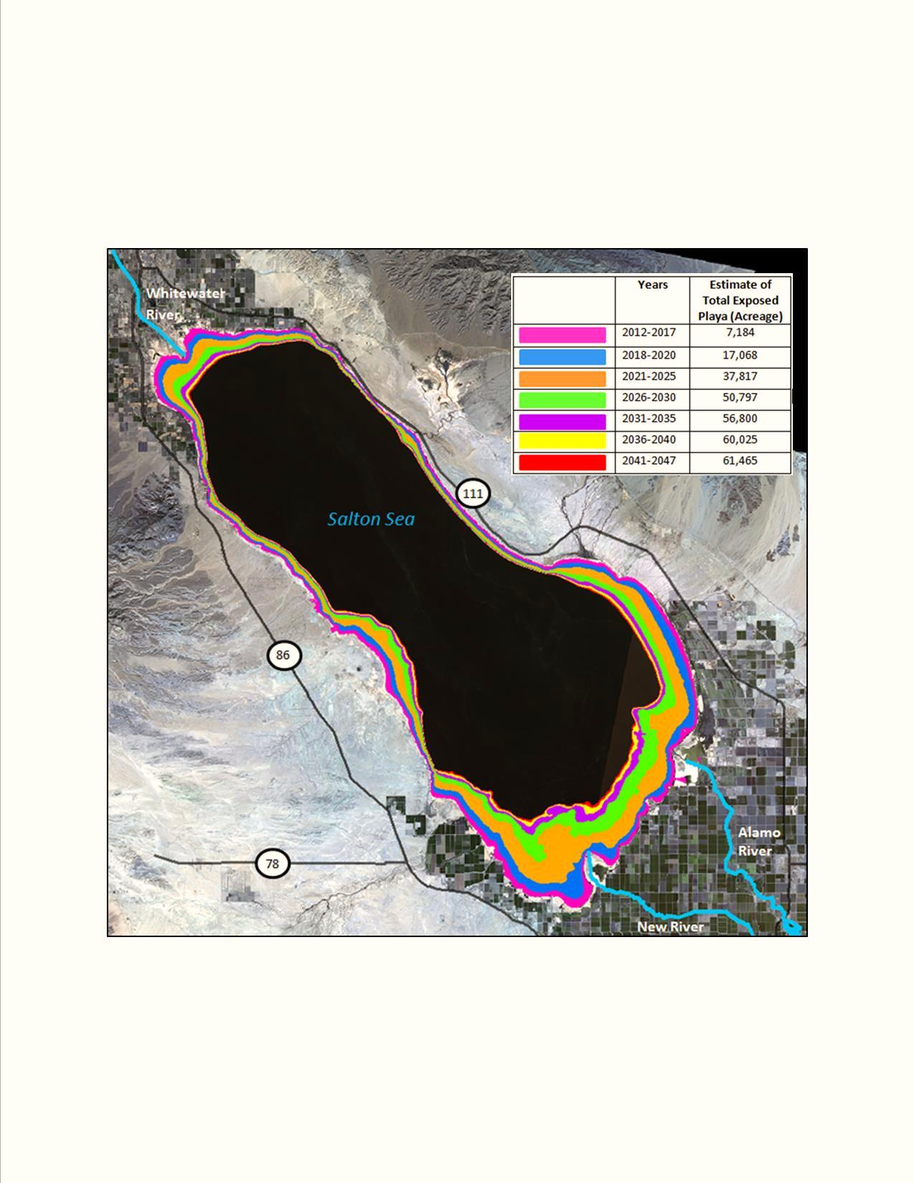
ESTIMATED TOTAL PLAYA EXPOSURE

Slide 5
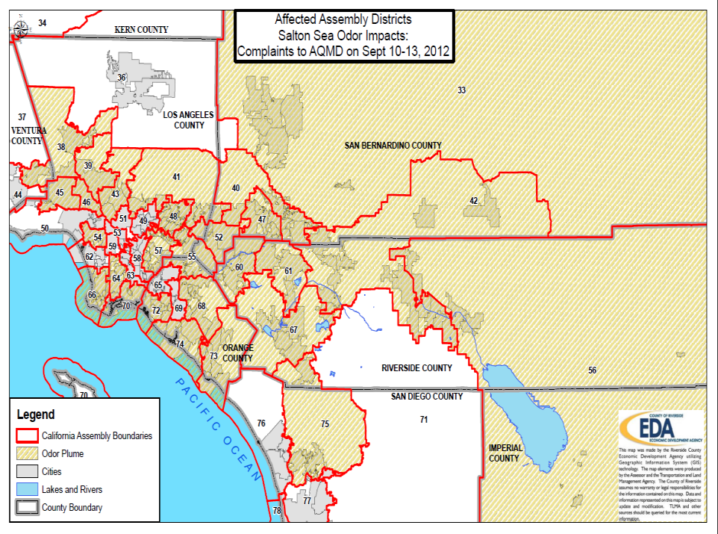
Notes:
Big Hydrogen sulfide plume in 2012, shows how the winds carry toxins not only to areas around the Salton Sea but to most of Southern California.
Used to show people in DC and Sacramento that this isn’t just a local problem.

Slide 6
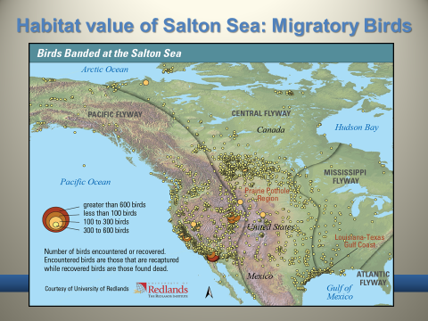
Notes:
Vital stop over to over 400 species of birds on the pacific flyway.
Tell story about egret in parking lot.

Slide 7
Financial Feasibility Action Plan
Historic MOU for cooperative land use planning to develop a Perimeter Lake
Precursor to the SSMP

Slide 8
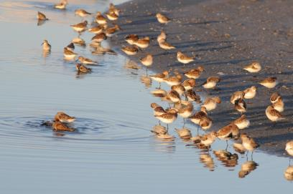
Stable Shoreline = Multiple Benefits
SSMP 10-year plan:
  Goal: Smaller sustainable sea
  State obligation: AQ, Habitat
  Local benefits:
    Recreation
    Renewable Energy
  Protects up to 30,000 acres of potentially emissive playa
Notes:
The SSMP 10-year plan will implement dust suppression and habitat projects to protect human health and restore crucial wetland habitats on 28,900 acres around the Salton Sea.
This plan also seeks to work with local stakeholders on how to do so in a way that promotes recreation and renewable energy.

Slide 9
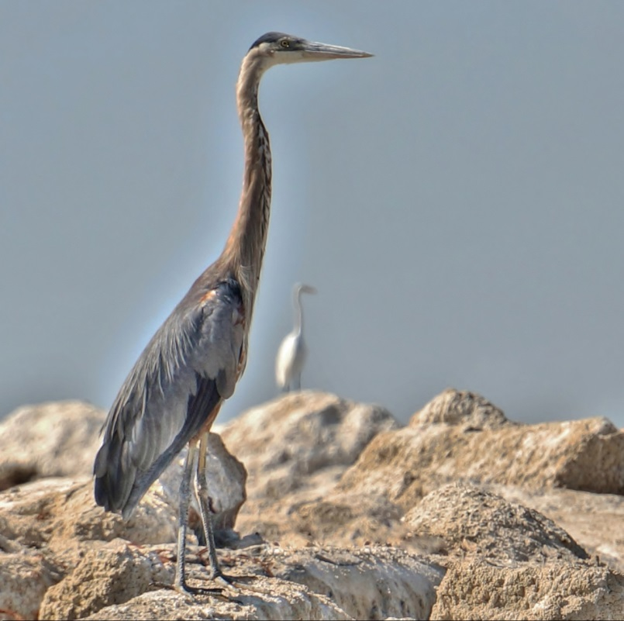
Status of the Salton Sea
Status Quo = declining ecology & economy
North America’s largest and most diverse migratory bird habitat outside the Everglades
Salinity approaching 2 x ocean
Algae blooms in Sea occasionally kill fish
Water transfers in 2017: reduced inflow
Less inflow: shoreline will shrink
Exposure of nearly 100 sq miles of playa
Air quality decline: odors and dust

Slide 10
DO NOTHING scenario
$70 Billion in Damages
“The most costly and irresponsible of all options”

Slide 11
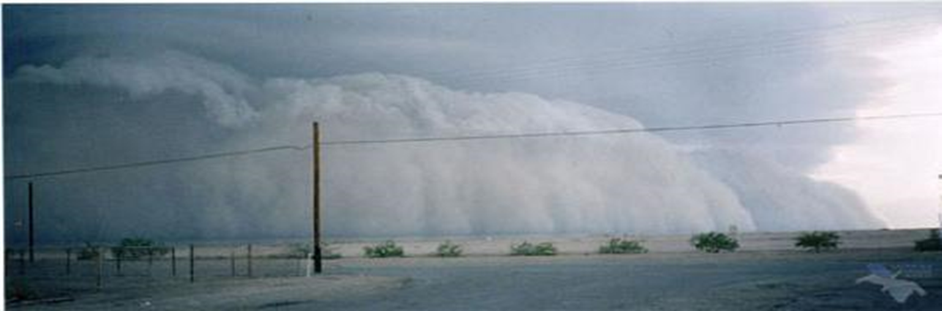

Notes:
So potentially this if we did nothing but I believe with the progress we are making it will be more along the lines of this- next slide

Slide 12
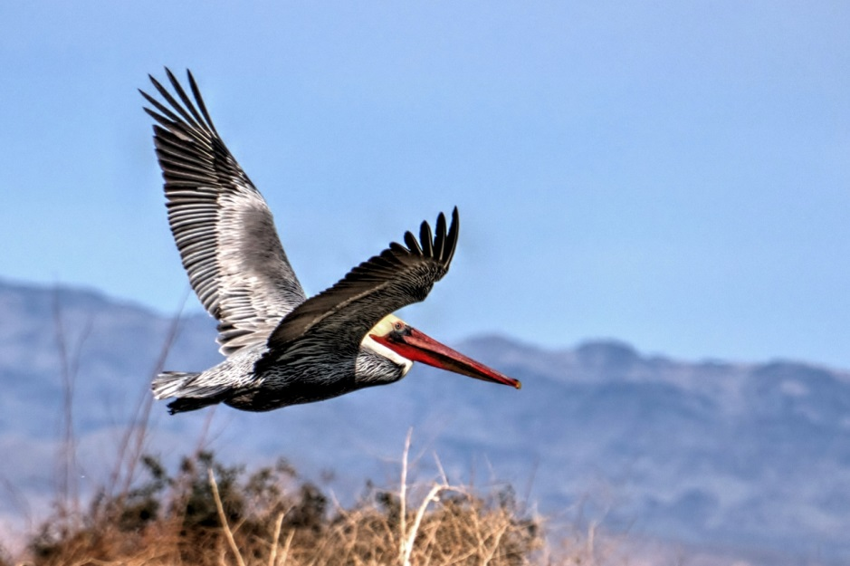
Significant progress at the Sea
Breakthroughs in cooperation
Governance clarified
Policy enhanced
Funding expansion

Slide 13
Governance: AB 71 (Perez)
Governor and Legislature direct the Ca Natural Resources Agency to work in Cooperation and Consultation with the Salton Sea Authority on matters pertaining to Salton Sea revitalization.

Slide 14
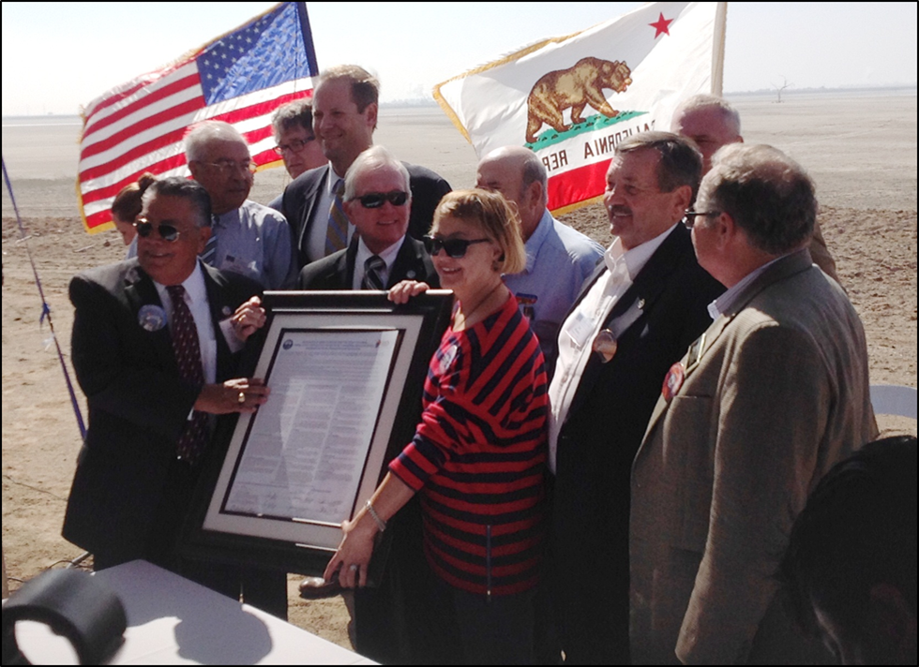
Improved Trust = Legislative Support
Funding
  State $$
    Prop 1: $80.5 M
    Prop 68: $200 M
  Federal $$
    Dept of Ag :$9 M
    Army Corps: $30 M
SAVINGS: Construction $ and Time
  Dam Safety considerations
  Design-Build capability for Sea projects
Notes:
Tell about when you have come on note the past, and the major progression that has happened over the past 2 years.
$270 towards 10 year plan out of the $400 million estimated cost
Dam safety regulations , no more evaluation needed for one over 6ft tall which is a major victory considering how the north lake is progressing.
Potential November bond- Prop 3 has another $200 million

Slide 15
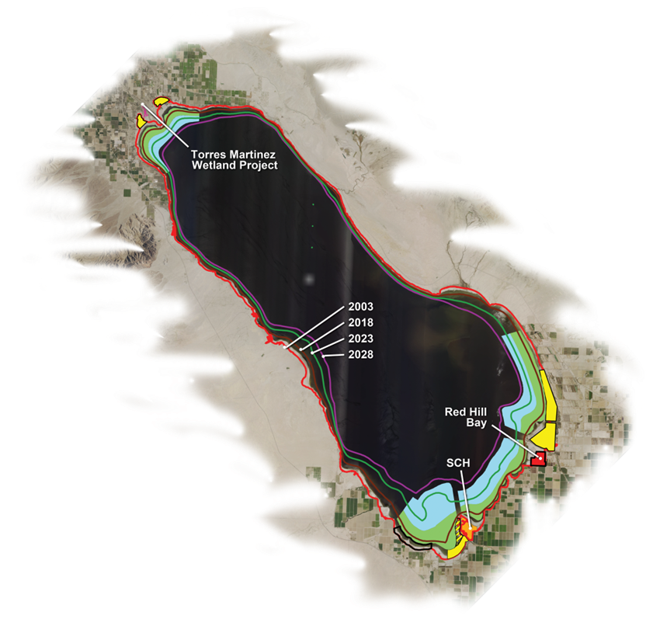
SALTON SEA MANGMENT Program 10 Year PLAN
Realistic, Feasible, Actionable
Shovel-ready projects
Ready available funding
Not perfect or complete, but good first step

Slide 16
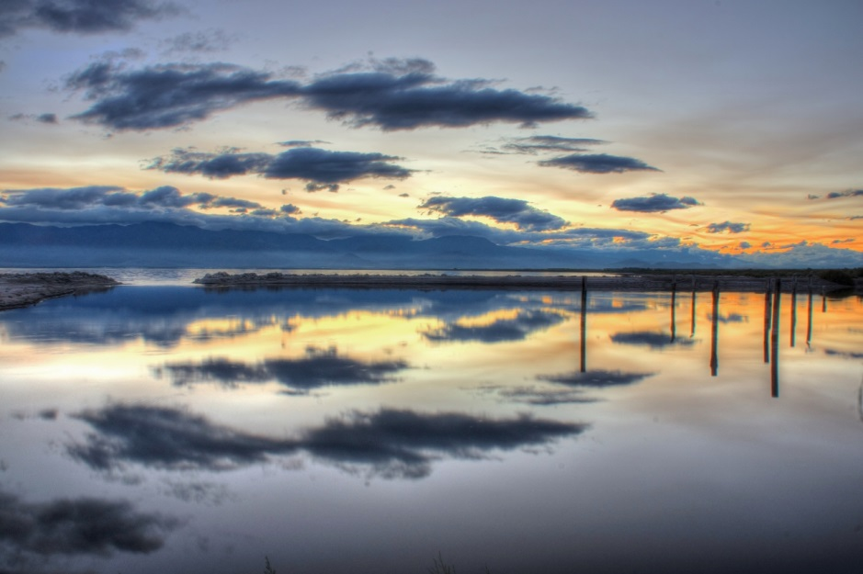
NEAR-TERM DESIGN & CONSTRUCTION
Current projects
  SSA/Torres Martinez Wetland
    Phase 2 Expansion
  Red Hill Bay
  New River East - (SCH)
Proposed 2020
  New River West
  Whitewater River

Slide 17
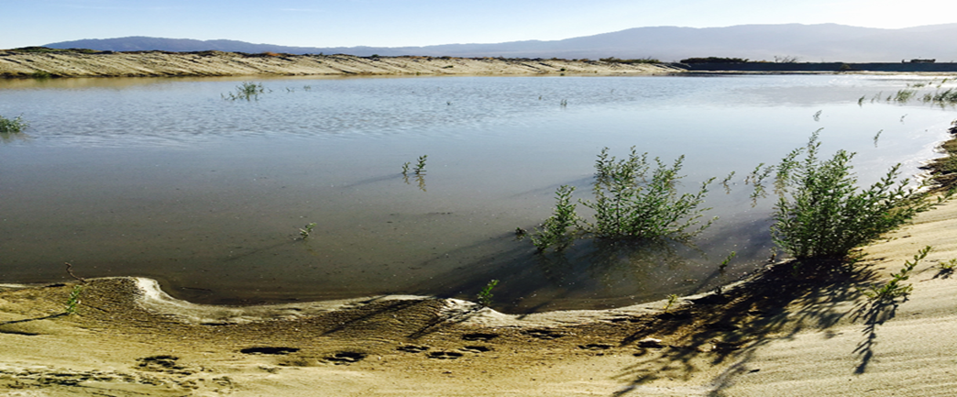
SSA Delivers First state-Funded Project ever Completed at Salton Sea
Completed by Salton Sea Authority
  On Time
  Under Budget
    Contracted with state
    In partnership with Torres Martinez Tribe
Notes:
Benefits: -Creates freshwater habitat
- Covers dusty exposed playa
- Reconstruct ponds serving as habitat that were wiped out by storm flows
- Invasive plant removed from most of the ponds; water source secured by rehabilitating a small groundwater well
46 acres, shallow ground wells, mid- deep habitat
Currently working on finalizing phase 2 contract with state

Slide 18
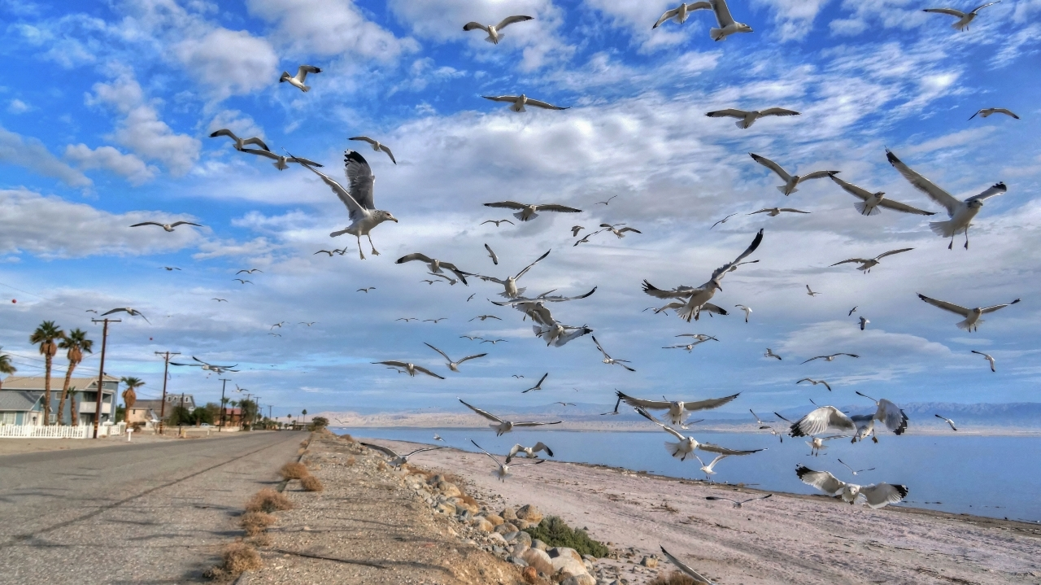
New sources of Funding
Local
  Infrastructure Finance Districts
State Water Bond
Federal
  US EPA
  US Dept of Agriculture

Slide 19
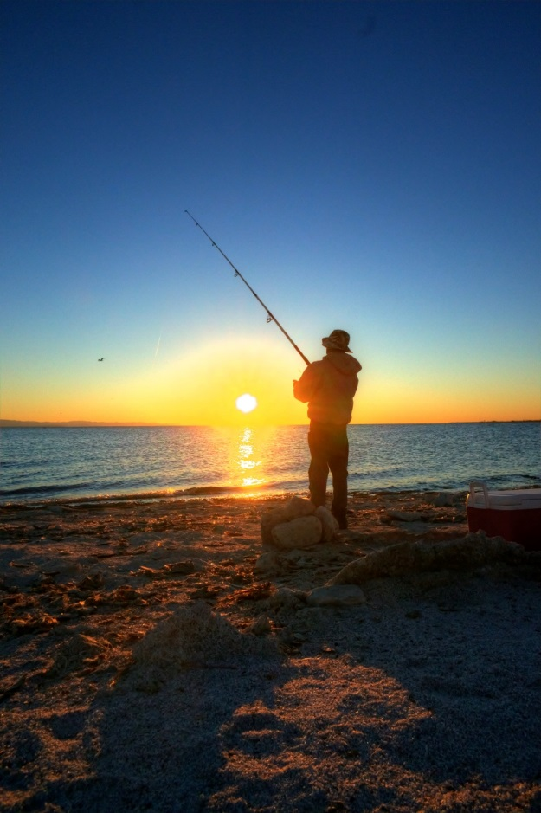
Infrastructure Financing Districts (IFD)
NOT a new tax
NOT a change in tax rate
Leverages existing local property tax
Requires a defined project providing clear benefits
Notes:
- Infrastructure Financing Districts (IFDs) provide a tool for local governments to finance infrastructure providing community-wide benefits.
- An IFD can capture and dedicate a portion of local property tax toward a specific project designed to improve property values.
- The Salton Sea IFD would be funded by property tax increments generated by development that is enabled by the seaside infrastructure.

